Slide 1

Portfolio Overview: The Pines Group
Prepared by,
Connor Button
20236241
Presented to:
Jim Hamilton
COMM 231

Slide 2
Size-Up & Insights
Real Value to End-User
Integration of services eliminates need to manage multiple contractors
Trained staff to operate heavy machinery that customers are unable to use
Custom solutions tailored to property with pre-project design
Painful, Serious Problem
Premature client base for non-construction (maintenance/planting)
Unfilled maintenance schedules leads to bleeding of efficient time
Robust Market, Margin, $
Growing regional market following covid of affluent homeowners and cottagers
10-15% profit margins support self-funded growth
3,500+ residential units in permitting pipeline indicate strong demand
Good Fit, Timing
Established staff, equipment, and strong local construction reputation in place
Self-financing model enable expansion into other segments now
Proven growth trajectory for landscape and carpentry with consistent revenue increases

Slide 3

Performance Goals & Issues
Goals
Increase qualified leads for non-construction segments.
Achieve 50% growth in maintenance for the 2026 landscape season
Maintain current KPI’s in construction segment; same proportional qualified leads, continued full schedule for both landscape crews and carpentry crew.
Internal & External Issues
Owner Dependent for selling and quoting jobs; significant time lost selling rather than strategic management.
Limited marketing budget focused mostly on content
Limited to physical capabilities; Additional qualified leads in fully scheduled segment has diminishing returns
AI utilized only for content creation
Large landscape competitors with massive market share
Local maintenance only providers have large hold on market; economy of scale

Slide 4

Marketing Strategy Overview
Highlight recurring maintenance in marketing communications
Grow maintenance & other under performing segments
Shift sales time away from owners onto sales agents
Continue to grow well-performing segments
Increase local brand awareness

Slide 5
ICP Described
Pines Group (ICP)
Wealthy home-owners/firms representing
Enjoys outdoor living spaces
Prefer self managed professionals
Value adding property investments
Decision makers are often financiers or adjacent
Buyer: Residential home-owner or home builder
End User: Home-owner or company
Influencers: Designers, Project managers
Maintenance/Lawns (ICP)
Home-owners of all kinds
Corporate offices/spaces
Value convenience over money saving
Non-DIYers
Prefer annual/seasonal contracts for simplicity
Buyer: Home-owner, Property manager, Facilities
End User: Residents, Office workers
Influencers: Property manager, word of mouth

Slide 6
Positioning
“Southern Georgian Bay’s Premier Landscaping and Building Company”
Emphasis on being a trusted partner in crafting beautiful, creative, and unique properties, seamlessly integrating homes and landscapes at a premier level.
Company Values:
Expertise & Attention to Detail
Passion & Dedication
Team Excellence
Local, Owner-led
Client Partnership
Maintenance Focused
Long Term Sustainability
Fast, Friendly & Responsive Service
Experts in Horticulture & Property Care
Southern Georgian Bay’s premier Landscaping and Building company
Reliable partners for all year-round needs.
Design Build Manage Maintain

Slide 7
Total Customer Experience
Need for service → Creates initial designs → Collect quotes → Decides on contractor → Creates detailed designs ↓
Continued communication ← Project execution
Pain Points
Lack of trust in quality and timing
Hard to differentiate poor and good quality companies
Hard to pinpoint reasoning for price difference
Delays; Issues with timeline communication
Non-continued relationship for future inquiries
Targets
Build trust with prospective clients
Communicate quality by showing examples not just through company testimonial
Free quotes and transparent pricing
Accurately communicate schedule and projected timelines
Stay connected with clients for future services

Slide 8
Revenue, Pricing & CAC:LTV
Year | Revenue | Maintenance | Other segments | Profit | Marketing Spend
2023 | 1,500,00 | 0 | 1,500,00 | ? | ?
2024 | 2,300,000 | 0 | 2,300,000 | ? | ?
2025 | 3,000,000 | 150,000 | 2,850,000 | 500000 | 31000
~2026 | ~4,200,000 | ~225,000 | ~3,975,000 | ~630,000 | ~43,400
Segment | Clients
Landscape | ~16
Carpentry | ~5
Maintenance | ~6
$1990/customer CAC for quoted projects
Project revenues/project average
Carpentry ≈ $210,000
Landscape ≈ $112,500
Maintenance ≈ $20,000 (small landscaping jobs)
≈ 1600 (seasonal lawn + garden care)
LTV
Carpentry ≈ $44,065
Landscape ≈ $20,585
Maintenance ≈ $485 (Small Jobs)
≈ $1,920 (seasonal lawn + garden care)
Segment | Profit
Landscape | ~0.2
Carpentry | ~0.2
Maintenance | ~0.12

Slide 9
Distribution & IMC
Primary Focus
Branding
Online Presence
Portfolio Creation
2026 Approach
Door to Door sales early in the season to expand recurring maintenance customer base
AI Website chatbot implementation for assistance and quoting
Highlighted stories on Instagram for each segment
Before and After shots for maintenance
Enhance SEO into SEM for sponsored results and targeted ads
Largest competitor currently has #1 sponsored result
Currently don’t show up until third non-sponsored result
Off-season traditional ad push
Communications
Content Marketing
Traditional advertising
Partnerships
Motion Filming
2Seven
OurHomes Magazine
Thornbury Home Hardware

Slide 10

Lawn & Garden Maintenance
Spring Cleanup
Planting
Mulching
Garden Design
EARLY BIRD SALE!
TILL FEBRUARY 1st

Slide 11
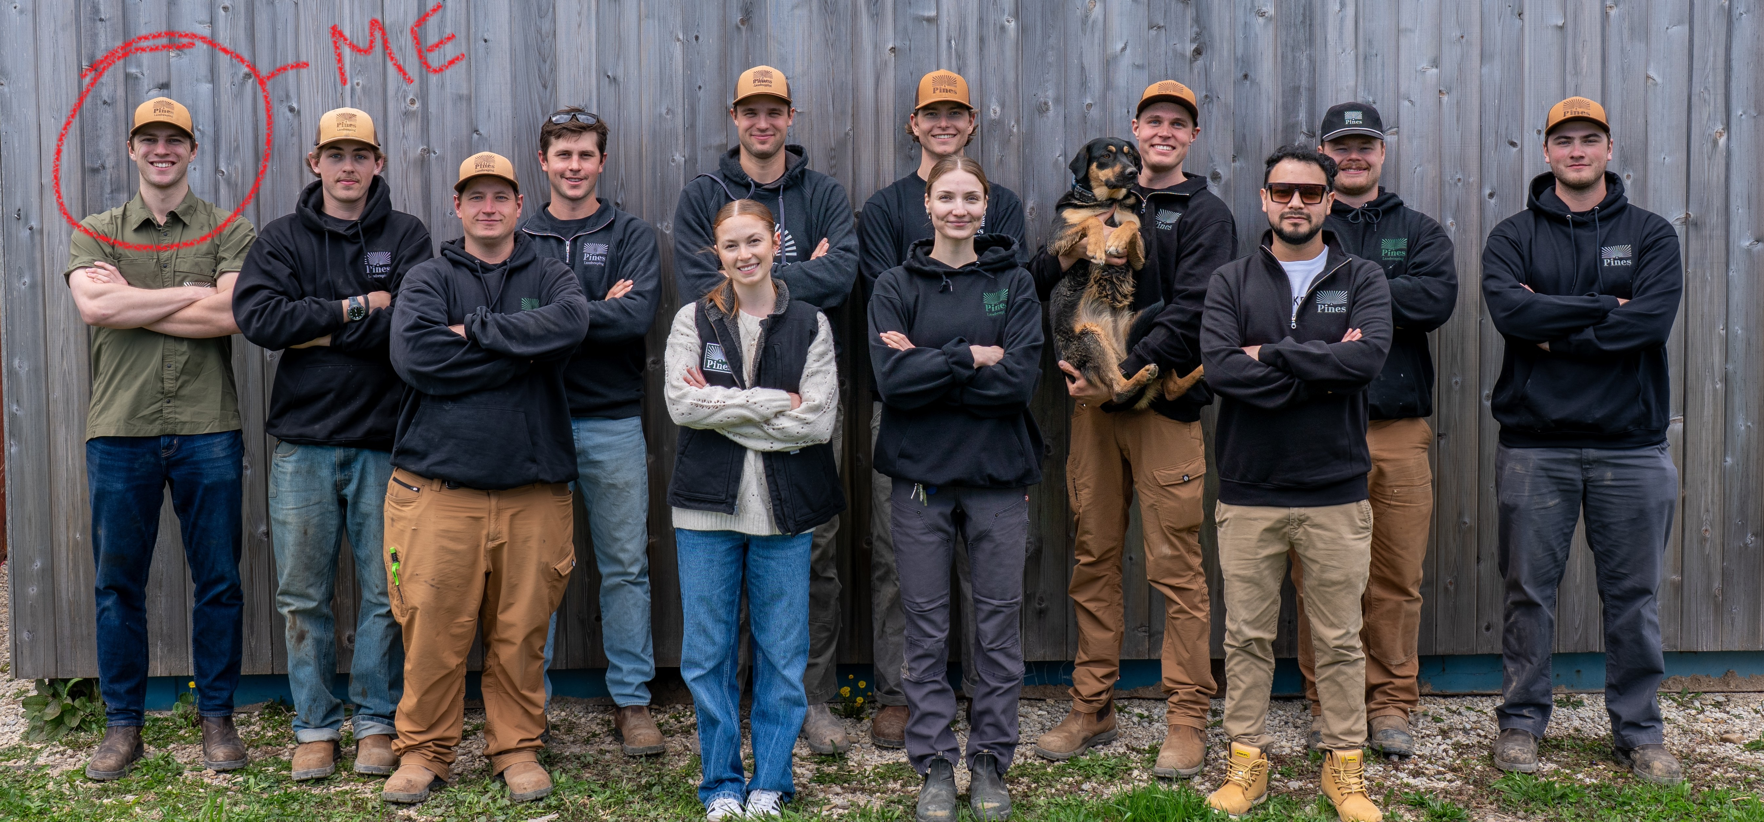
Conclusion

